Slide 1
“But my patients are sicker …!”
Capturing comorbidities using R packages
Hojjat Salmasian, MD, MPH, PhD
Harvard Medical School Brigham and Women’s Hospital

Slide 2
Scenario
Dr Luv operated on 48 patients with breast cancer last year. Of these, 18 died within one year from their surgery.
Dr Kil operated on 48 patients with breast cancer last year. They matched Dr Luv’s patients in terms of age and disease stage. Of these, 25 died within one year from their surgery.
What do you make of this?

Slide 3
Comorbidities
Medical conditions that are present concurrent to the key condition being studied, or at the time of the procedure being studied
Famously captured using a comorbidity index or measure
Charlson Comorbidity Index (CCI)
Elixhauser Comorbidity Measure
Diagnosis-related Groups (DRGs)
Hierarchical Condition Category (HCC) model
etc.

Slide 4
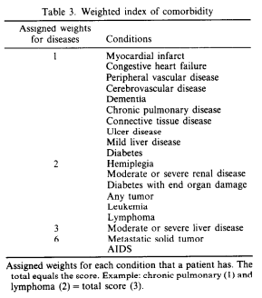
Charlson Comorbidity Index (CCI)
Originally developed by Mary Charlson et al. in 1988 (PMID 3558716)
Cohort: 559 medical patients
Primary Outcome: 1-year mortality
Data Source: chart review after patient discharge
Statistical Approach: survival analysis (Cox’s regression method)

Slide 5
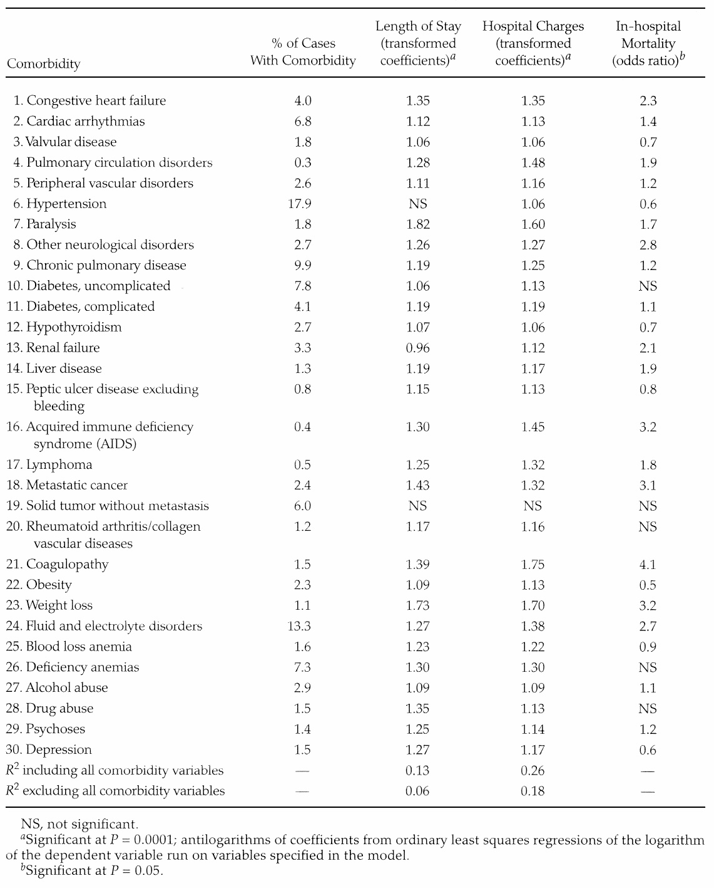
Elixhauser Comorbidity Measure
Originally developed by Anne Elixhauser et al. in 1998 (PMID 9431328)
Cohort: 7,779,167 discharges in 1992 in California
Primary Outcomes: mortality, hospital charges, LOS
Data Sources: claims data (ICD-9-CM)
Statistical Approach: OLS regression

Slide 6
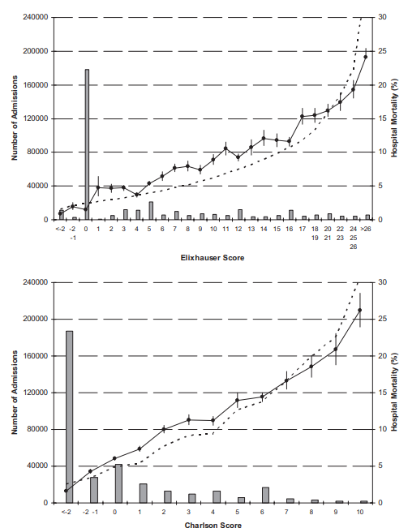
Comparison of calibration curves (PMID 19433995)
Notes:
Calibration curve of Elixhauser and Charlson comorbidity indexes for predicting risk of hospital death. These graphs present the calibration of the Elixhauser (top) and Charlson (bottom) comorbidity scores for hospital death. Each plot presents the number of admissions having each score (columns, left vertical axis). For each score (horizontal axis), the graph presents the predicted hospital mortality (broken line, right vertical axis) and observed hospital mortality (solid line, right vertical axis) with 95% CIs.

Slide 7
International Classification of Diseases
Full official name: International Statistical Classification of Diseases and Related Health Problems
Commonly referred to as ICD
Maintained by the World Health Organization (WHO)
Versions: ICD-6, ICD-7, ICD-8a, ICD-9, ICD-10, ICD-11
In the US, some procedure codes are also added to ICD, creating a “Clinical Modification” version of it (ICD-9-CM or ICD-10-CM)

Slide 8
ICD users in the US include …
Centers for Disease Control and Prevention (CDC), to classify causes of death
CDC used ICD-9 from 1979 and switched to ICD-10 in 1999
Payors, such as Center for Medicare and Medicaid Services (CMS) for billing purposes
ICD-9 was used by CMS until September 2015
ICD-10 is used by CMS since October 2015
Fun fact: ICD-10 was published by WHO in 1992
Fun fact: ICD-11 was approved by WHO in May 2019; it will come into effect in 2022

Slide 9
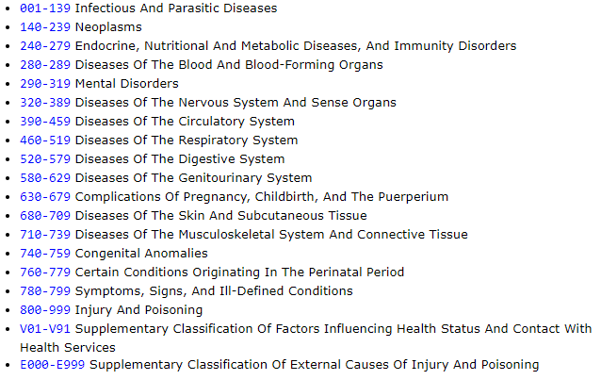
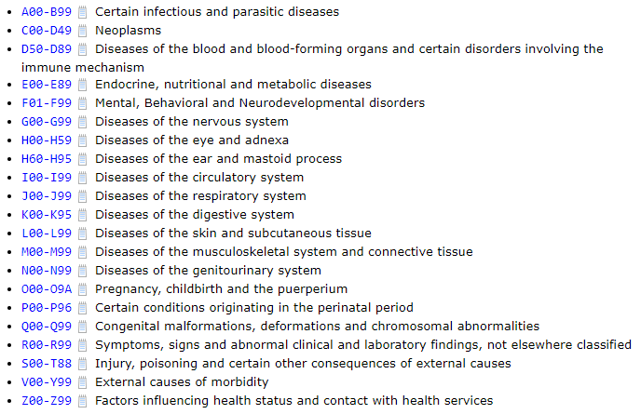
ICD-9 versus ICD-10

Slide 10
Special considerations using ICD codes
The “decimal point”
Example: Asthma
ICD-9: 493.90 (Asthma, unspecified type, unspecified)
ICD-10: J45.909 (Unspecified asthma, uncomplicated)
Particularly problematic with ICD-9 codes that start with zero:
Example: 002.0 (Typhoid fever)
With a bad data load, it can be stored as numeric value “2”!

Slide 11
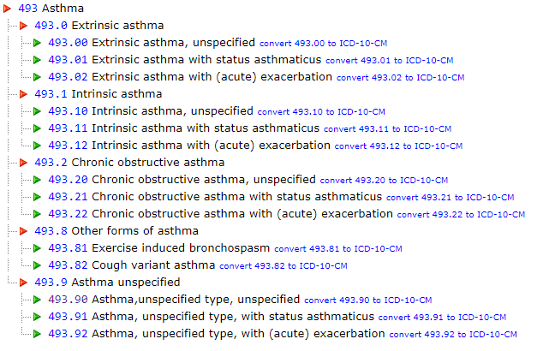
Special considerations using ICD codes
The “billable” codes
Example: Asthma!
Diseases Of The Respiratory System (460-519)
Chronic Obstructive Pulmonary Disease And Allied Conditions (490-496)
Asthma (493)
Screengrab from icd9data.com

Slide 12
ICD-9 versus ICD-10: special considerations
E codes and V codes
ICD-9 uses V codes to describe factors influencing health
Example: V86 (Estrogen receptor status)
ICD-9 uses E codes to describe causes of injury
Example: E991 (Injury due to war operations by bullets and fragments)
ICD-10 codes start with a letter, which may be an E or a V!
Example: E84.0 (Cystic fibrosis with pulmonary manifestations)
Example: V71.0XXA (Driver of bus injured in collision with pedal cycle in nontraffic accident, initial encounter)

Slide 13
New ICD codes are added each year
ICD-10-CM codes added in 2019 include:
C43.11 Malignant melanoma of right eyelid, including canthus
C43.111 Malignant melanoma of right upper eyelid, including canthus
C43.112 Malignant melanoma of right lower eyelid, including canthus
C43.12 Malignant melanoma of left eyelid, including canthus
C43.121 Malignant melanoma of left upper eyelid, including canthus
C43.122 Malignant melanoma of left lower eyelid, including canthus
…
F53.0 Postpartum depression
F53.1 Puerperal psychosis
…
Until 2018, only a parent code existed as F53 (Puerperal psychosis)
In 2019, these child codes were added

Slide 14
The point is …
Packages dealing with comorbidity data are bound to do string matching
While E and V codes from ICD-9 and ICD-10 do not overlap, not all of the current packages can “automatically” determine if your codes are in ICD-9 or ICD-10
None of the existing packages support specifying the version of the ICD code (e.g. ICD-10-CM version 2016 versus ICD-10-CM version 2017)

Slide 15
Capturing comorbidities: a moving target
Comorbidity measures are updated (e.g. in terms of “weights”) and “digitized” to work with ICD-9 and ICD-10
Deyo et al. 1992
Quan et al. 2005
Van Walraven et al. 2009
Moore et al. 2017 working with the AHRQ
Comorbidity measures are repurposed for additional use cases:
Predicting readmission
Predicting disease burden
etc.

Slide 16
R packages for comorbidity analysis
Package Name | Pertinent Functions | Notes
icd | icd9_comorbid_ahrq() icd9_comorbid_elix() icd9_comorbid_quan_elix() … | Support for: Charlson, Elixhauser, HCC Distinguishes between different “flavors” of the same measure (e.g. Quan vs Quan Deyo vs AHRQ vs …) Does not use parallelism or data.table
comorbidity | comorbidity() | Support for: Charlson, Elixhauser Distinguishes between some flavors of the same measure Uses parallelism; recently started using data.table
comoR (not in CRAN) | comorbidityPatients() | Calculates its own comorbidity measures (learned from data) Supports for genetic data as well as ICD and OMIM data
comoRbidity (not in CRAN) (source: GitHub) | query() comorbidityAnalysis() | Calcualtes its own comorbidity measures (learned from data) Supports for gene-disease relationships
medicalRisk | icd9cm_charlson_deyo() icd9cm_elixhauser_quan() … | Support for: Charlson, Elixhauser (both ICD-9 only) Distinguishes between some flavors of the same measure Has not been updated since 2016

Slide 17
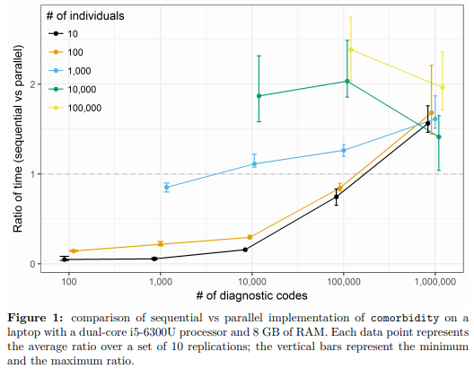
Performance: parallel processing
From Gasparini 2018. Licensed CC-BY 4.0

Slide 18
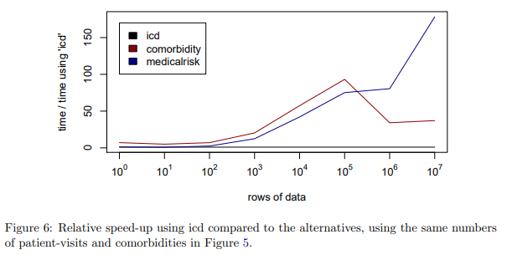
Performance: as of 2018
From Wasey et al 2018. Copyright belongs to authors.

Slide 19
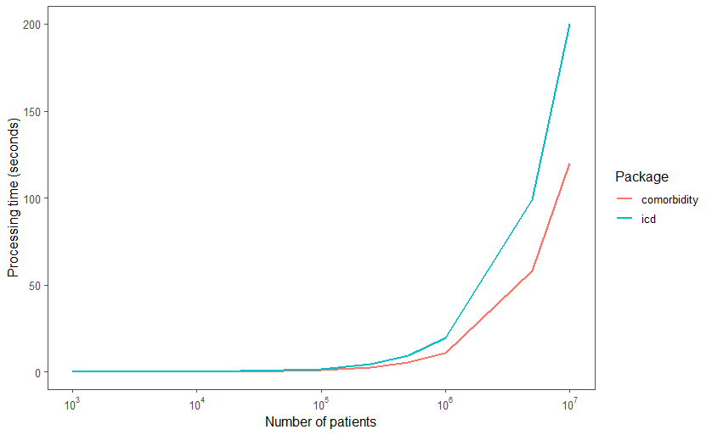
Performance: latest versions (as of 2019)

Slide 20
Discussion: issues with ICD codes
Example:
Quan et al vs AHRQ’s definition of Elixhauser
AHRQ captures “leukemia” through DRGs, Quan does not capture it at all
AHRQ includes C86* in the definition of “lymphoma”; the code did not exist at the time of Quan et al’s paper
To include or not to include 498.82 for COPD
comorbidity includes it because Quan et al defined the COPD range as “490.x-505.x”
icd does not, because 498.82 is not a valid ICD-9 code (and neither is its parent, 498, indeed)

Slide 21
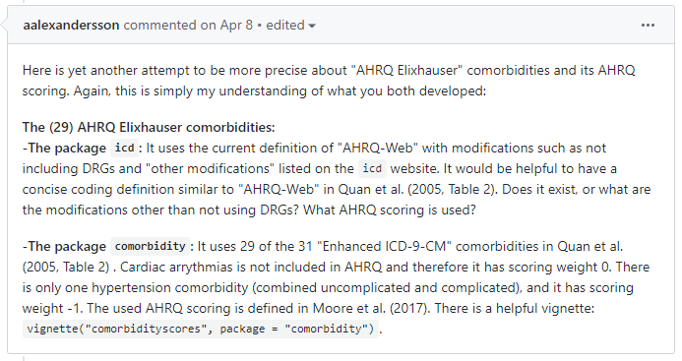
Discussion: issues with measure definitions

Slide 22

Next steps
Help with the issues
Make your own package!
Here is a proposal for its name and icon:

Slide 23
Questions?
Ask now!
Or reach me at hsalmasian@bwh.harvard.edu

